Slide 1
Kafka as middleware for Rubin control
Tiago Ribeiro et al.
William O’Mullane (presenting)
SPIE Yokohama 18 June 2024
Paper 13101-44 16:30 - 16:50 Japan Standard Time | Room G314, North - 3F

Slide 2
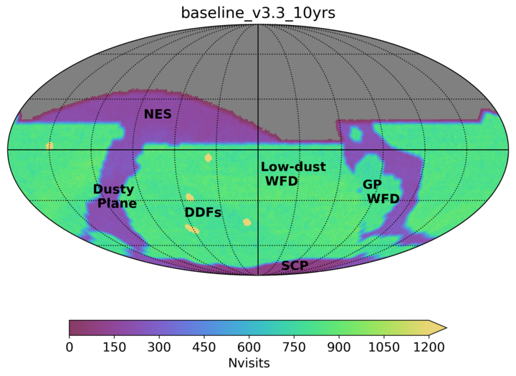
Vera C. Rubin Observatory - LSST
Rubin - Cerro Pachón Chile (ops 2025)
Legacy Survey of Space and Time (LSST)
An optical/near-IR survey of half the sky in ugrizy bands to r 27.5 (36 nJy) based on 825 visits over a 10-year period: deep wide fast.
90% of time spent on uniform survey: revisits every 3-4 nights, the whole observable sky scanned twice per week
100 PB of data: about a billion 16 Mpix images, enabling measurements for 40 billion objects!
Large fast telescope plus auxiliary - fully commandable observatory.
2023 (v3.3)
10-year simulation of LSST survey: number of visits in u,g,r band (Aitoff projection of eq. coordinates)
Ivezic et al. (2018)-arXiv:0805.2366
Notes:
%It’s about 5,000 sq. deg. per night, *twice*, on
%average. That is, about 1,000 visits per night on average. You return to
%the same position on the sky in about 3-4 nights (in any band). Btw, it’s
%a nice coincidence worth remembering that the total exposure time per
%position over 10 years (in all bands) is equal to about one observing night.

Slide 3
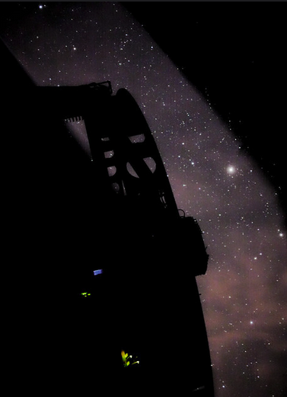
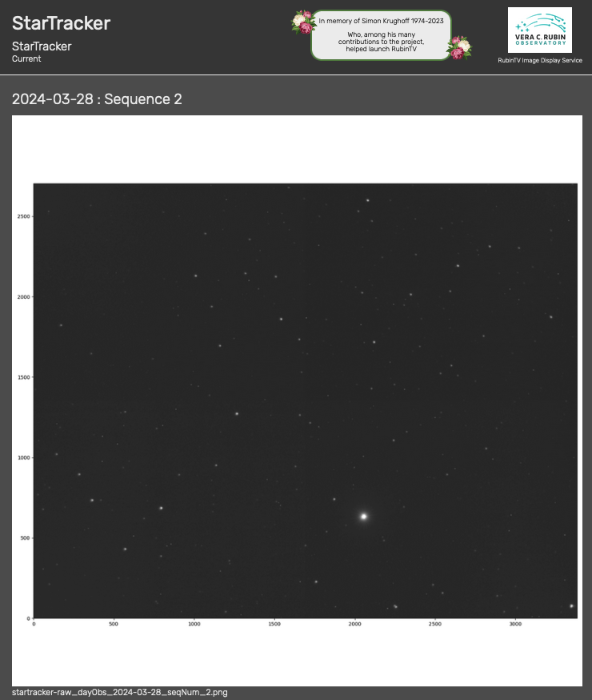
Simonyi telescope on sky
Commissioning camera will go on in July 2024.
Telescope testing on going for more than a year.
Two star trackers mounted on side of TMA facilitated testing on sky since 2023.
Paper 13094-8, B. Stalder
RubinTV quick look
From startracker
28 March 2024
Inside Rubin dome TMA silhouette
21 Feb 2023

Slide 4
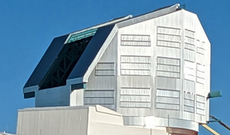
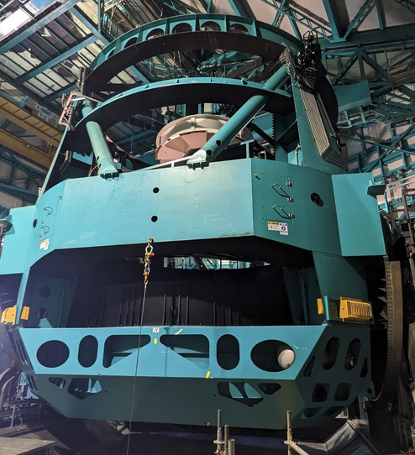
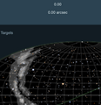
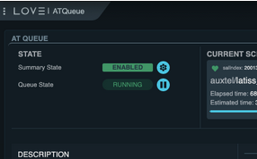
Observatory Control System (OCS)
Physical
Devices e.g
Commandable
SAL Components
(currently > 60 CSCS)
Lots of networking/cables/fibres
Dome CSC
MTMount
Scheduler
ScriptQueue
LOVE
EFD
Message bus proposed Kafka
Engineering Facility Database
Message bus (currently DDS)
Foreman Puppet
Kubernetes
Kubernetes
Almalinux 9.4 + some specific machines in computer room

Slide 5
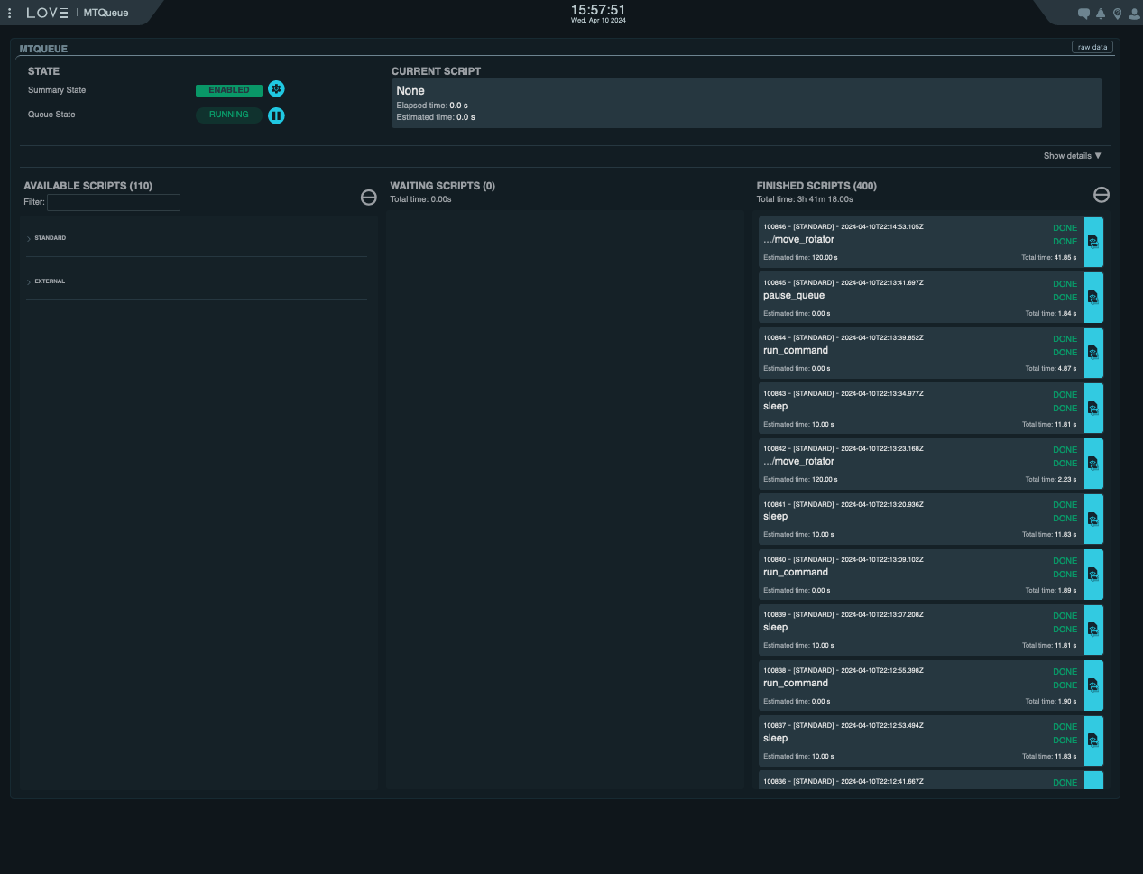
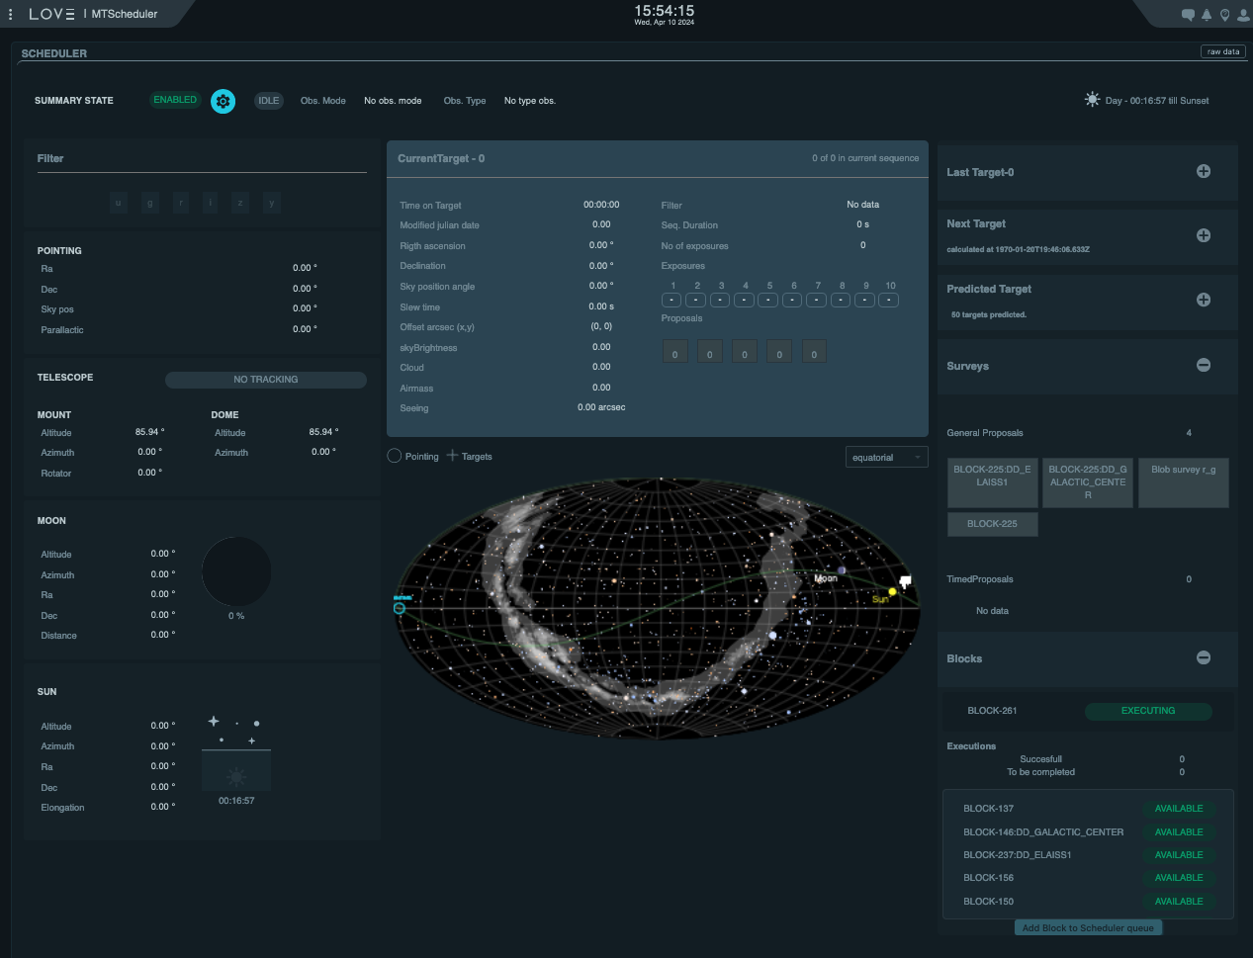
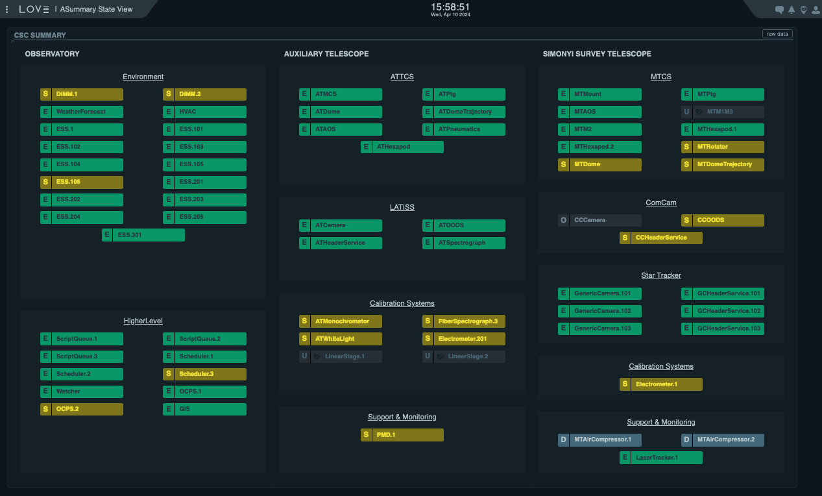
Running Test and Observations at the Summit
Activities are executed with Scheduler-driven operations in mind.
Scheduler can run scripted operations composed of a series of SAL Scripts, executed by the ScriptQueue (a.k.a. Blocks) or be used in survey mode.
Soak test has been executed routinely, using the same software that powers the survey simulations.
This is also the same software that has been in use for years now to operate AuxTel.

Slide 6
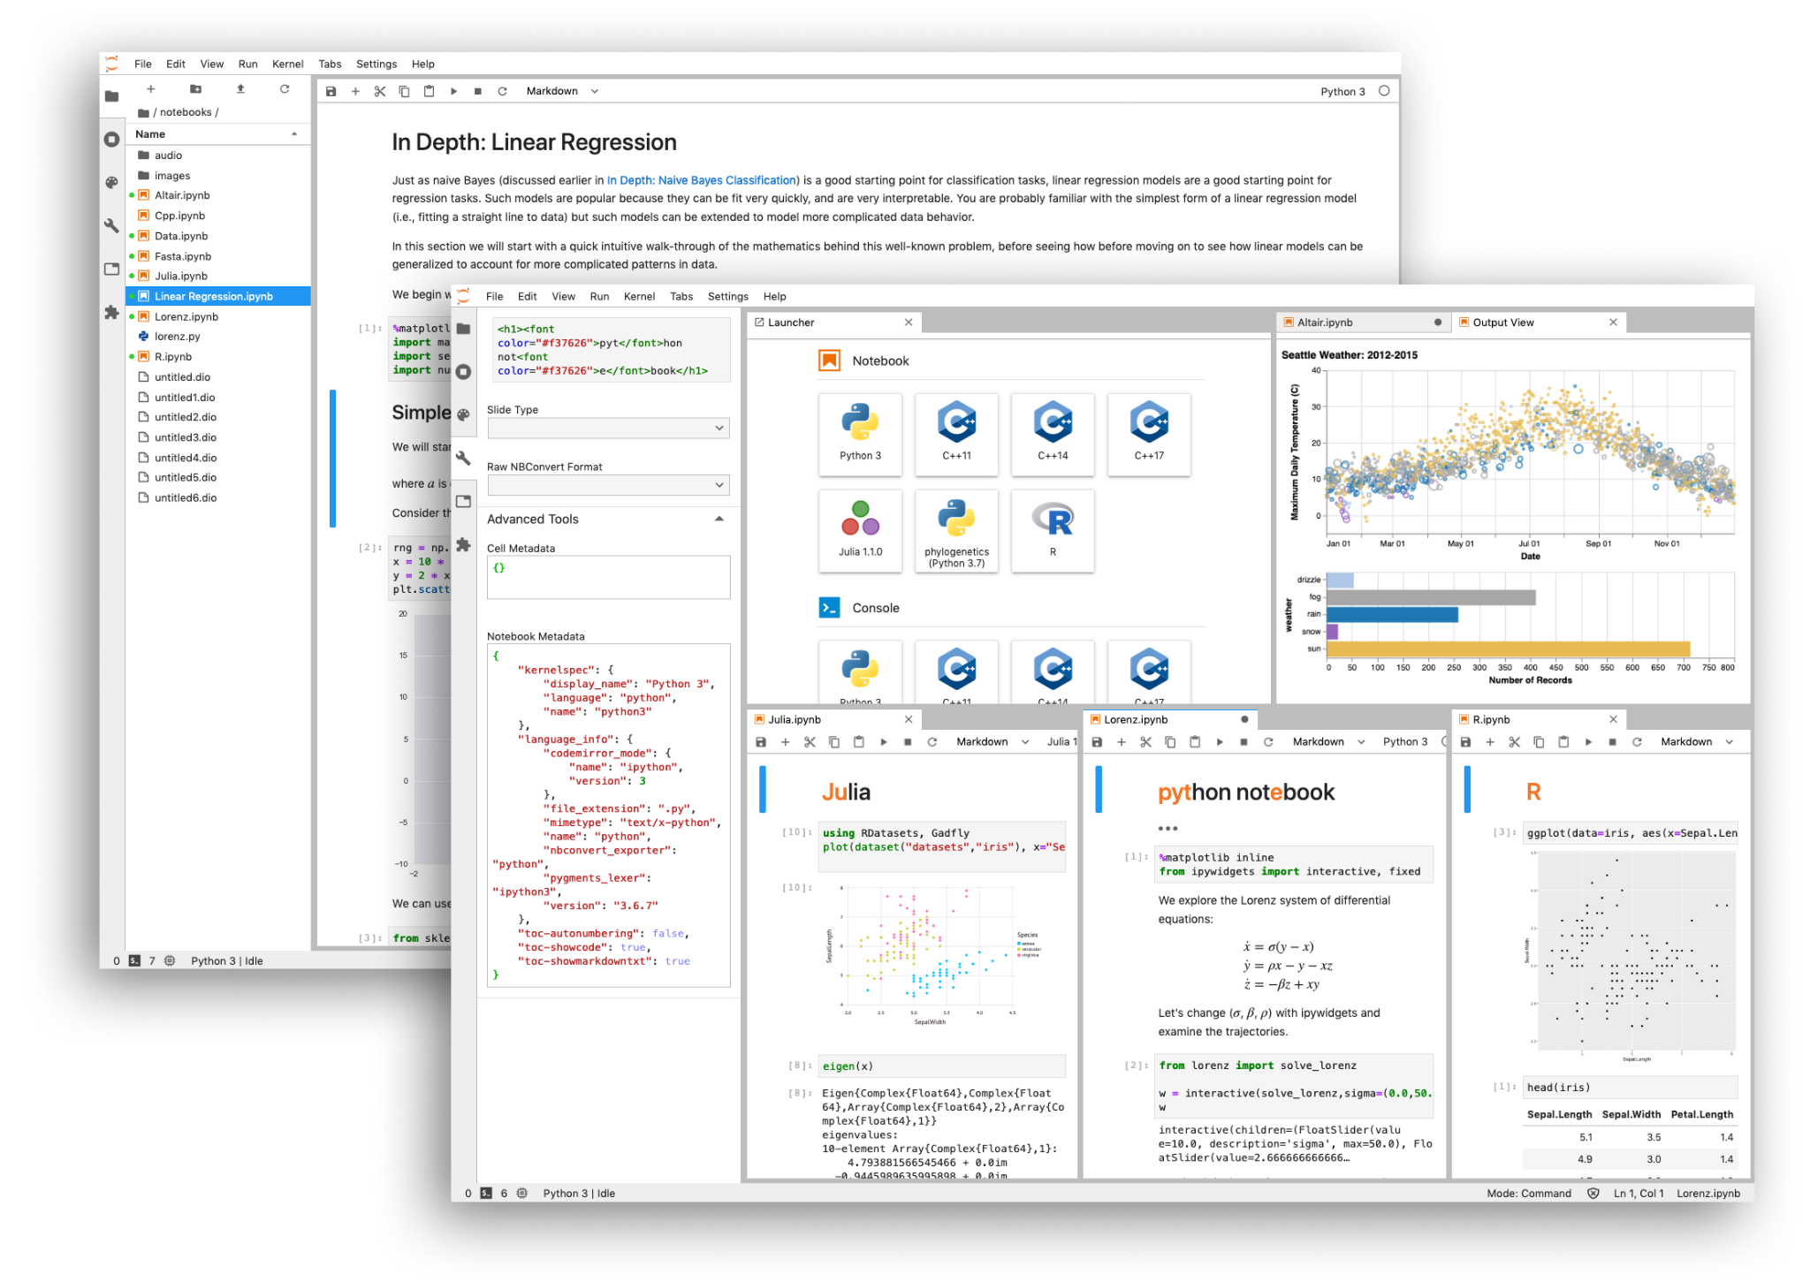
Bonus points
INDUSTRY 4.0?
All telemetry in influxdb
See Fausti talk tomorrow - same room G314 and time 16:30 - 13101-59
Rubin Science Platform is deployed with the OCS builtin
Economou earlier 13101-37
A set of introductory Jupyter examples are provided to users which are easily expandable to accomplish complex tasks.
Excellent flexibility for commissioning

Slide 7
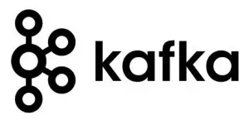
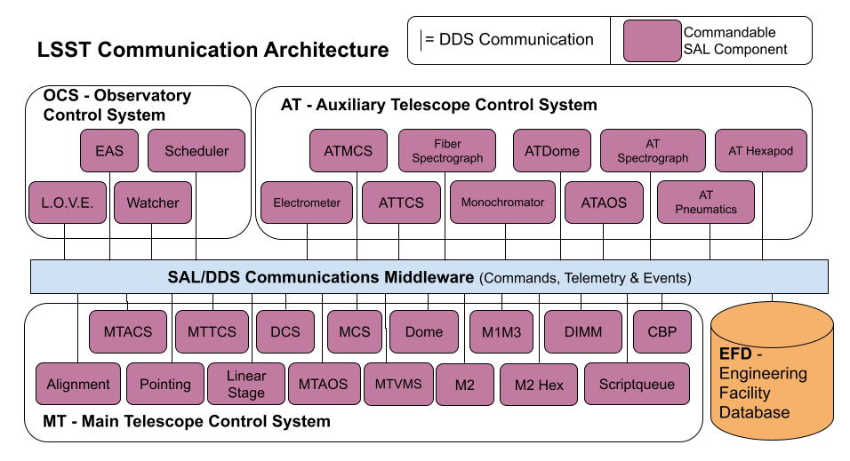
TSSW - Middleware
While the current DDS implementation is stable, it is very finicky and it’s future has some risks, see tstn-028 and tstn-033.
Toward the end 2022 agreed to go for a new kafka middleware
SalObj Kafka development complete. SAL development took a long time - main developer sidetracked with other fires (TMA, DIMM, LaserTracker). SAL work severely underestimated.
Containers set up, Tucson Test Stand testing started
Hope for Summit deployment late 2024
Credit: A. Clements
Notes:
Do this now as we have (1) the resources with us and (2) it would be easier than trying to do this during operations

Slide 8
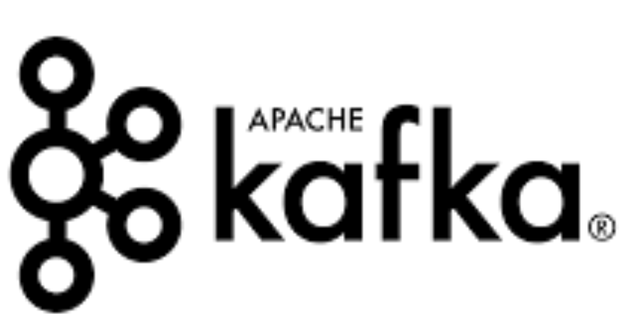

Kafka vs DDS
Kafka
Publish/Subscribe model
Topics
TCP/IP, Durability (late-joiner)
Brokered
no discovery phase
No topic schema (we adopt AVRO)
Partitions and number of ACKs
Data Distribution Service
Publish/Subscribe model
Topics
TCP/IP, Durability (late-joiner)
Distributed
UDP multicast/discovery
Rigid topic schema
Complex quality of service per topic
Liveness

Slide 9
What we actually need
Average latency better than 25ms.
Latency standard deviation better than 3ms.
Throughput better than 3 MB/s per topic.
Consumers must be able to keep up with the data they read.
Must be able to handle the full system throughput.
Engineering Facility Database already captures all data and is Kafka/Influx based - we know Kafka can handle the message throughput.

Slide 10
Tests
Choose three representative topics:
MTM1M3 summaryState: One of the smallest topics.
MTMount trackTarget: priority latency.
This is the command sent by the pointing component to the mount with on sky pointing demands.
Requires the 3ms latency
MTM1M3 forceActuatorData: The largest topic in the system, which is also published at 50Hz. This topic sets the per topic throughput requirement.
For DDS use the config we finally hae working
For Kafka we performed the tests using two different settings:
ack=0, meaning the writers will not wait for confirmation - not safe just for info
ack=1, meaning the writers will wait for 1 acknowledgement from the broker.
Notes:
ack =0 – This is not considered safe, and is provided purely to show how much latency is due to waiting for acknowledge- ment.

Slide 11
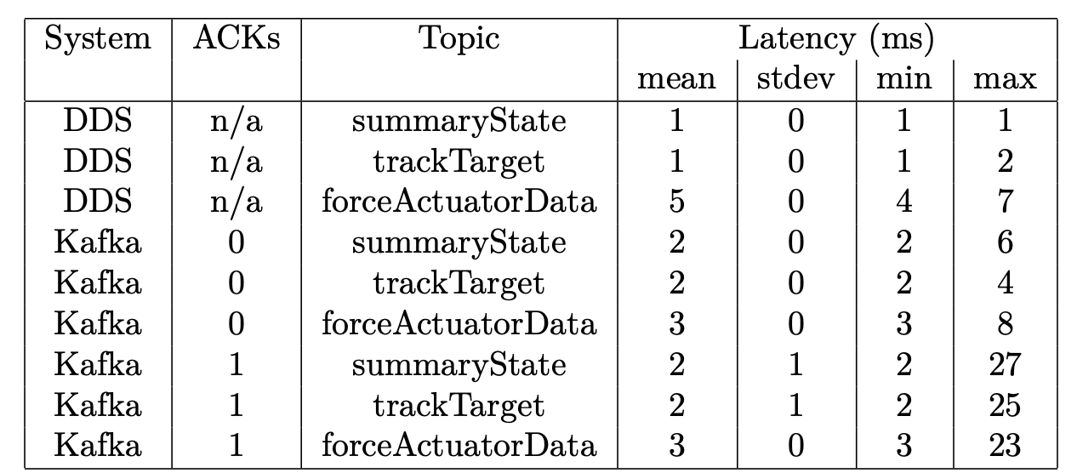
Result - Latency measurement

Slide 12
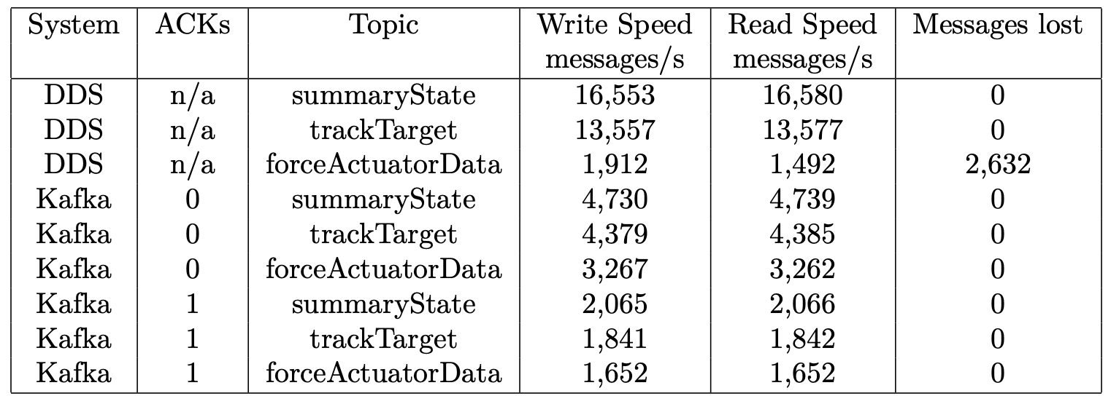
Result - Write speed
Conclusion - Kafka is viable

Slide 13
Migration is underway
Most CSCs use SALObj in house python layer to talk to DDS
Yea we convert that to kafka and a lot of the job is done
But some critical stuff is in C++
Pointing and M1M3 support
So some work needed (which is mostly done)
Some is Java
Camera control
Java has native Kafka
Integrating on our test stand now !

Slide 14
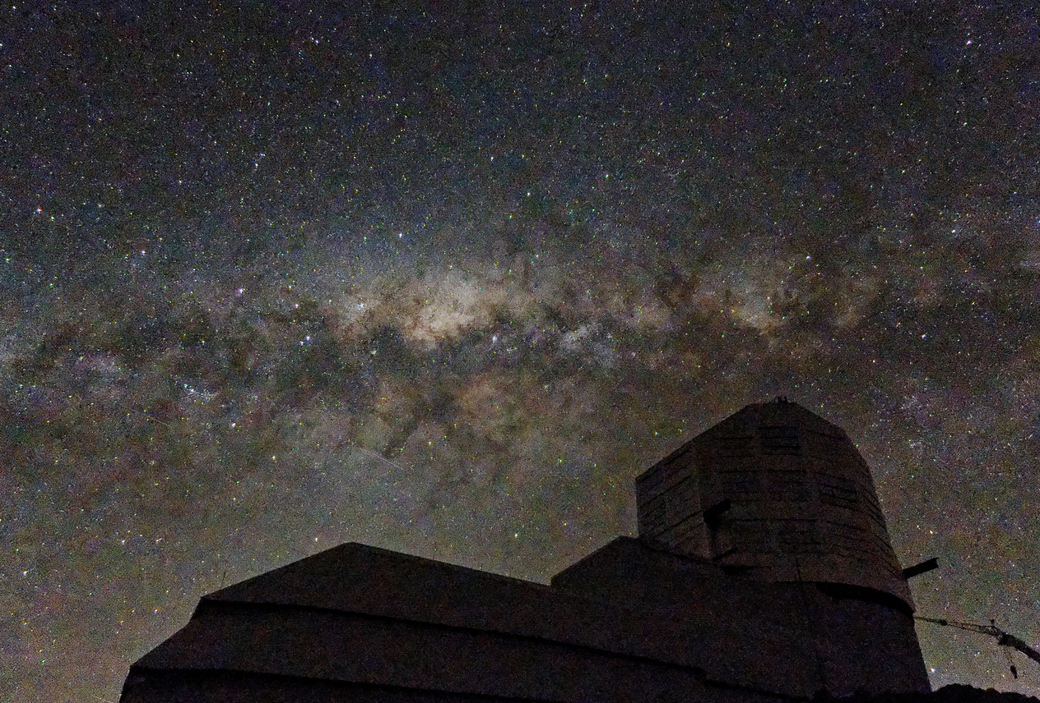
Rubin Observatory October 2023
Questions??
Photo: William O’Mullane
10s with Lumix GX9 f/3.5

